Slide 1



Sockets and Plugs
Extensibility without boilerplate
Stability without stagnation
Code examples available at
diffplug.com/opensource
Ned Twigg
@nedtwigg
DiffPlug
@diffplug

Slide 2
1, 1,
0, 1,
1, 2,
2 Fibonacci
1 Fibonacci again
3 Numbers
Notes:
“Congress shall make no law respecting an establishment of religion, or prohibiting the free exercise thereof; or abridging the freedom of speech, or of the press; or the right of the people peaceably to assemble, and to petition the Government for a redress of grievances”
- Easy to articulate a principle which turns out to be ambiguous.
- Lawyer technique is to say something three times:
“I promise to tell the truth, the whole truth, and nothing but the truth”
“I give, devise, and bequeath”

Slide 3


The three rules of plugin APIs
1
3
2
PLUG
SOCKET
Notes:
Many sockets have been written which only have one plug, with the idea that we are “future-proofing”.
YAGNI. You Aint Gonna Need It.

Slide 4

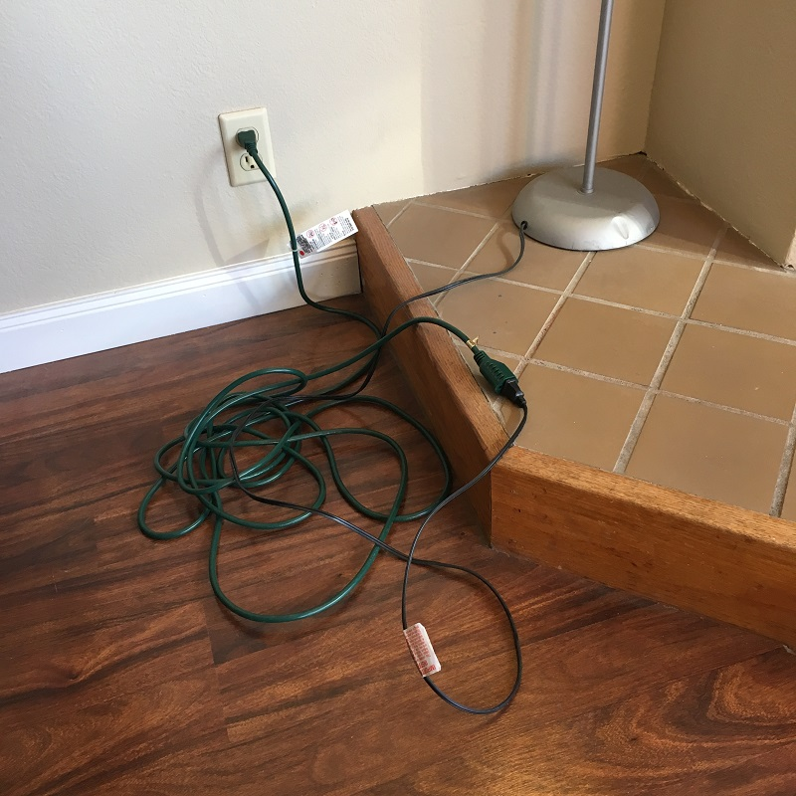
Future-proofing

Slide 5
The Plan
Look at the plugin system in VSCode and IntelliJ
Fixed sockets, dynamic plugs
Build a calculator in Eclipse
Dynamic sockets, dynamic plugs
“Declarative” metadata
Maven vs Gradle
Propose a system with the best of all worlds
AutOSGi

Slide 6
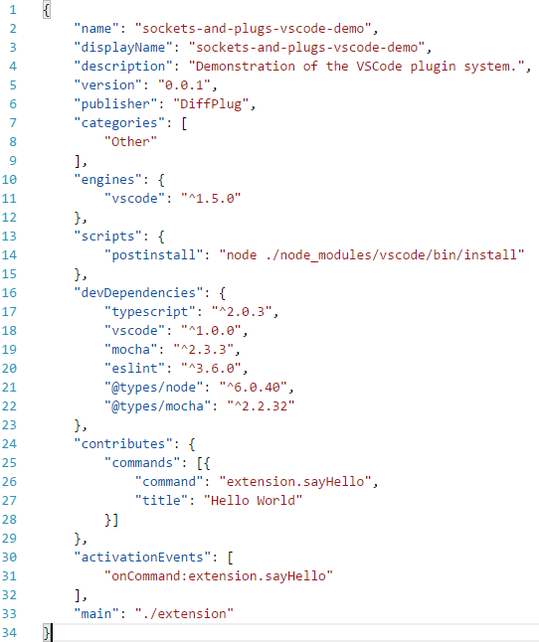
VSCode
package.json (extension manifest)
User-facing information
Similar to maven pom.xml
Dependency and build information
Plugin metadata
Notes:
VSCode -> Extension
Socket -> Contribution Point
Plug -> Contribution

Slide 7
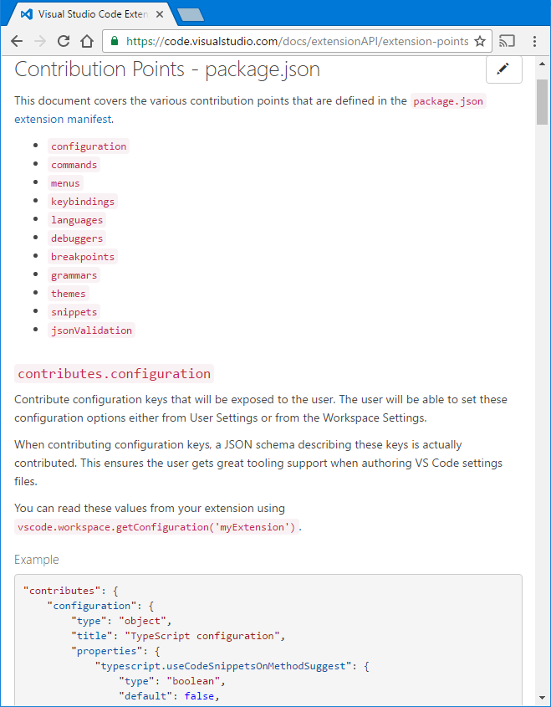
VSCode
package.json

Slide 8
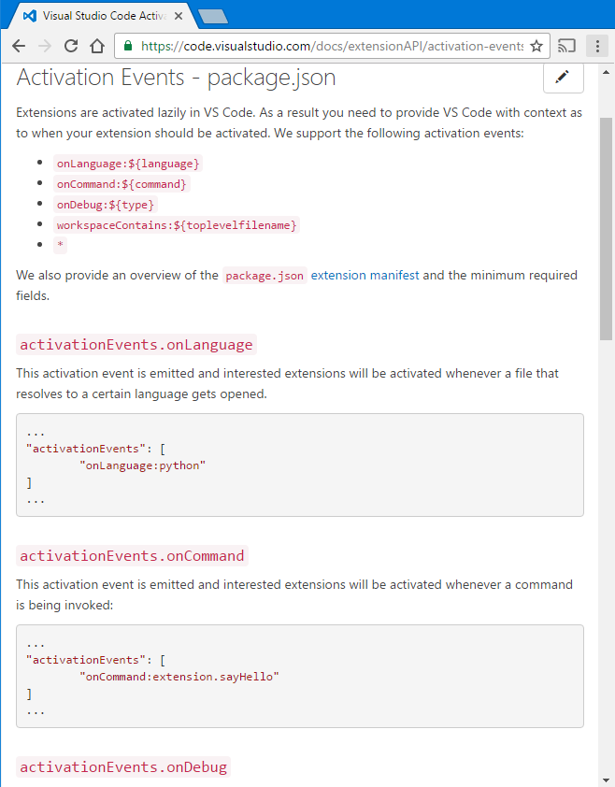
VSCode
package.json

Slide 9
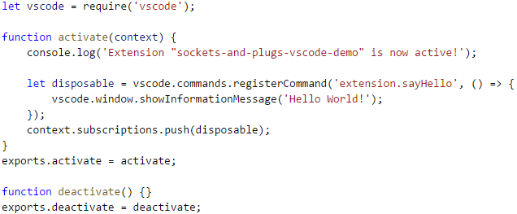
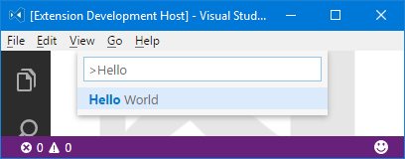
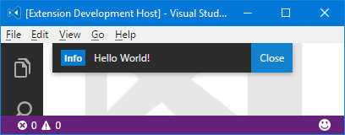
VSCode
extension.js
package.json

Slide 10
VSCode
package.json is a declarative description
What it contributes
When to load the code
Allows the code to be loaded lazily
Requires synchronizing package.json and the code

Slide 11
IntelliJ

Slide 12
Our calculator

Slide 13
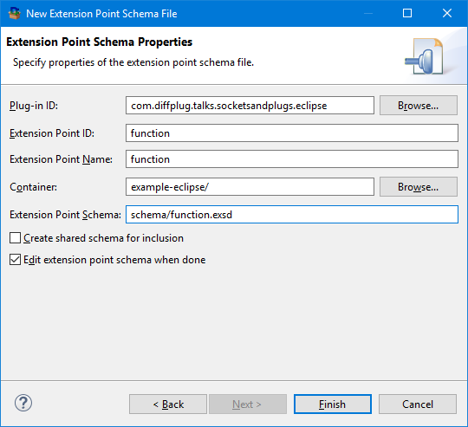
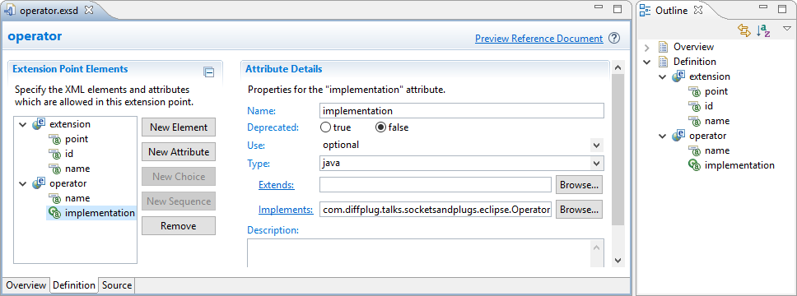
Eclipse
Socket -> Extension point
Plug -> Extension

Slide 14
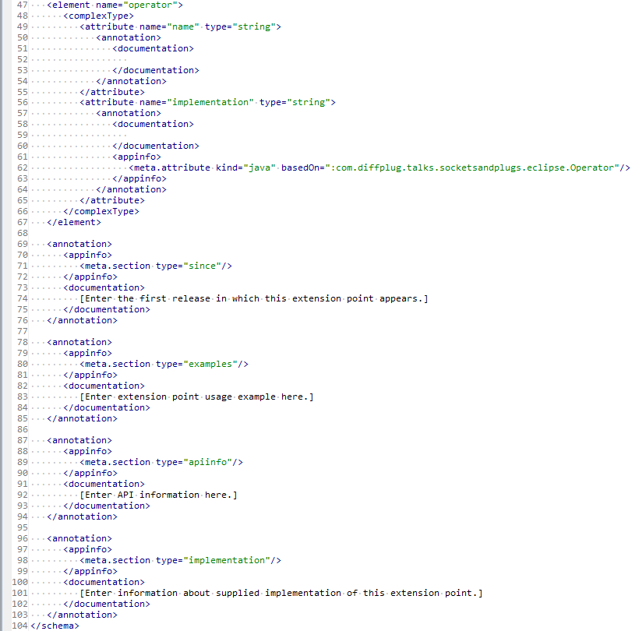
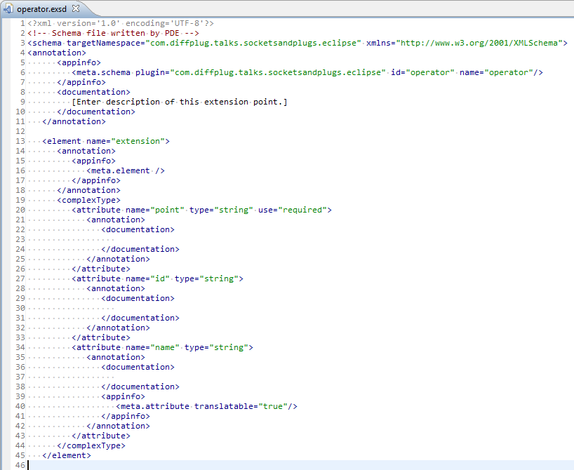

Slide 15

Boilerplate

Slide 17
IntelliJ

Slide 18
Maven vs Gradle

Slide 19
Which is more declarative?
A)
B)
C)
[1, 2, 3, 4]
List<Integer> list = new ArrayList<>();
for (int i = 1; i <= 4; ++i) {
list.add(i);
}
range(1, 4)

Slide 20
Which is more declarative?
A)
B)
C)
[1, 2, 3, 4, 5, 6, 7, 8, 9, 10, 11, 12, 13, 14, 15, 16, 17, 18, 19, 20, 21, 22, 23, 24, 25, 26, 27, 28, 29, 30, 31, 32, 33, 34, 35, 36, 37, 38, 39, 40, 41, 42, 43, 44, 45, 46, 47, 48, 49, 50, 51, 52, 53, 54, 55, 56, 57, 58, 59, 60, 61, 62, 63, 69, 65, 66, 67, 68, 69, 70, 71, 72, 73, 74, 75, 76, 77, 78, 79, 80, 81, 82, 83, 84, 85, 86, 87, 88, 89, 90, 91, 92, 93, 94, 95, 96, 97, 98, 99, 100]
List<Integer> list = new ArrayList<>();
for (int i = 1; i <= 100; ++i) {
list.add(i);
}
range(1, 100)

